Slide 1




IBM Internet of Things
Revit to Maximo
Doug Wood
Doug.wood@wipro.com

Slide 2
Planning for COBie data exchange

Slide 3



Digital Handover will overwhelm the owner with data
Hand-over data before BIM
What the owner wants for hand-over
The model needs to be filtered when hand-over data is generated. Hand-over data should only include:
All floors and spaces
Only assets that have:
Significant capital cost
Maintenance requirements that require tracking
Regulatory requirements
Product data for all included assets
Attribute meaningful to the FM process
Hand-over
data After BIM
Notes:
A major university we worked with has 1800+ buildings, and only 20,000 assets in their Maximo system. Not all of these are related to facilities.
Manual data entry is $150-$200/per hour plus cost of field inspection of the asset to gather the data – if available
Many customers report it takes a year or more to enter asset data for a new building into their FM system
A dump of the model of a new 200,000sq ft. lab produced 27,000+ assets.
Includes ever electrical outlet, light switch and air diffuser
This speaks to a need to filter the COBie data. Filtering can be done at export and/or at import

Slide 4
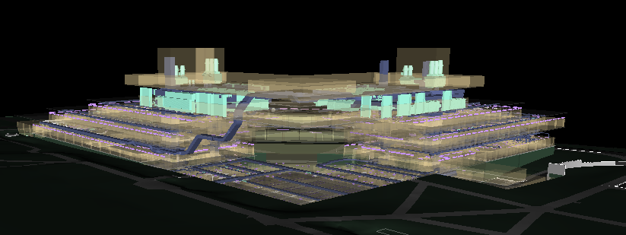
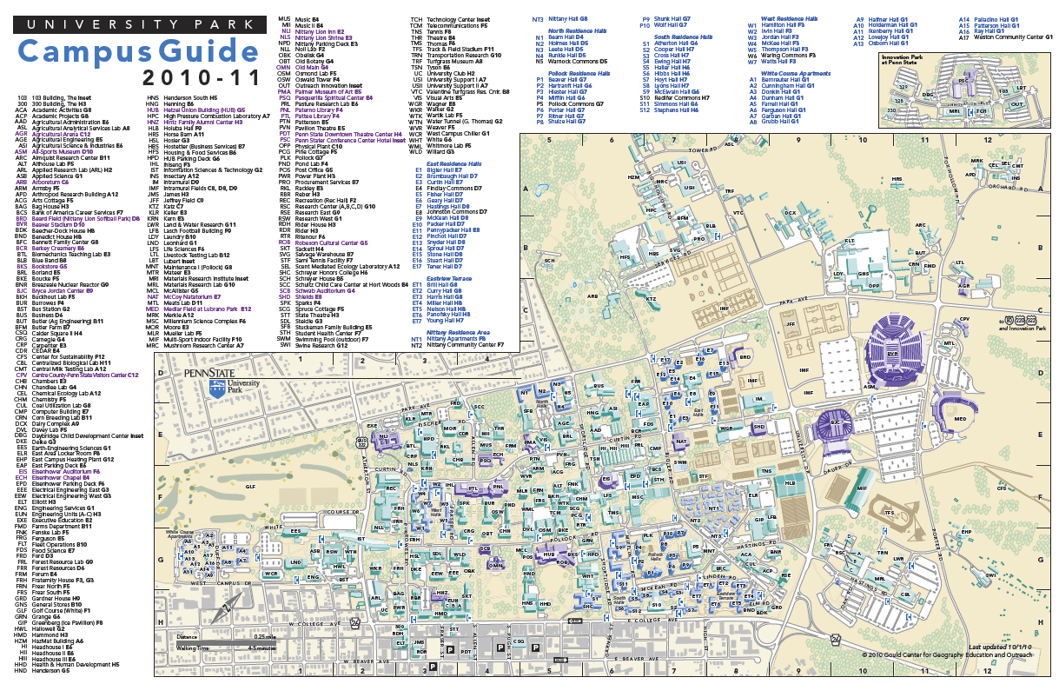
Project vs. Portfolio
The AEC Industry has a project centric view of buildings
Each project is unique with its own team contract approach, and data standards
Owner has a portfolio centric view
Example:
Major US university has 1800+ building over 2000 sq ft
US government agencies have portfolios of buildings ranging from several hundred to tens of thousands
All those building exist together in the owners CAFM and IWMS systems
The Owner needs consistency in their CAFM system across the portfolio
If the owner has established standards for location/room names, equipment names and classification, the project should use them
If not, the project team needs to work with the owner to establish standards or select acceptable industry standards,
Hand-over has to bridge the gap
Notes:
Impedance mismatch between how the owner thinks about buildings and how the AEC industry thinks about construction projects.
A successful digital hand-over needs to bridge the mismatch

Slide 5

Agreements required for a successful Digital hand-off
For which asset will data be provided?
For each class of assets, What set of attributes are expected?
What classification hierarchy will be used?
Is hand-over data expected in a standard format such as COBie
How is Equipment named?
When is the data expected?
If there is to be more than one drop,
what data is required for each drop?
Is digital product and maintenance documentation part of the Hand-over package?
If not, how are these files to be organized and delivered
What System will the owner use to store and manage these files?
How and when are barcodes assigned?

Slide 6


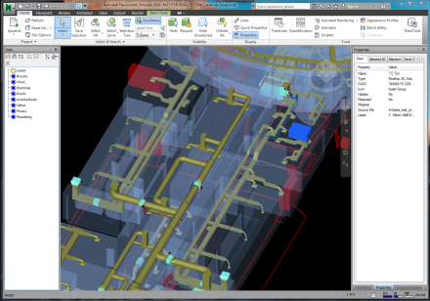
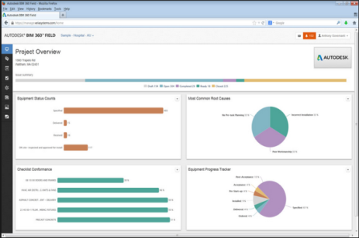
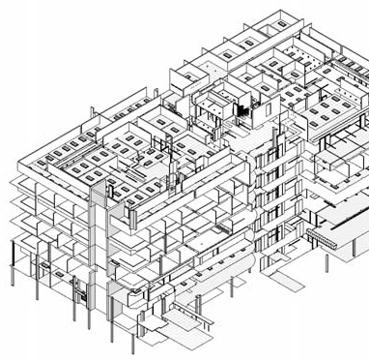
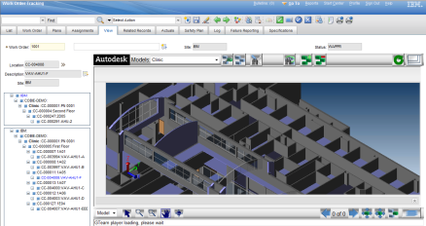
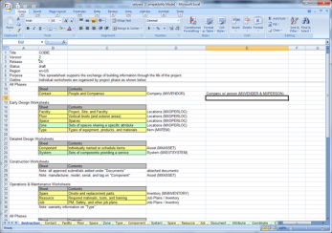
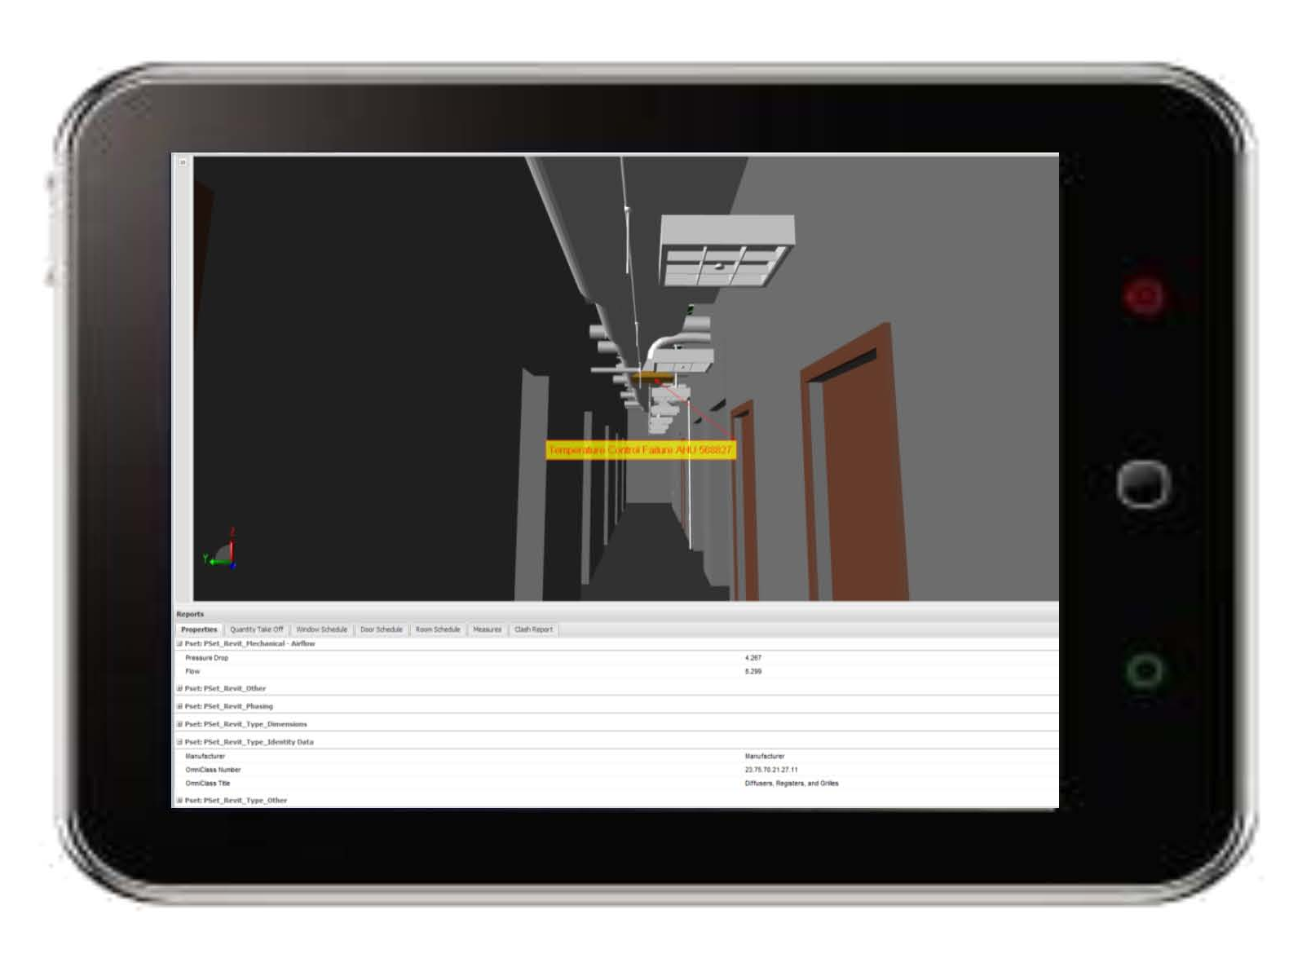

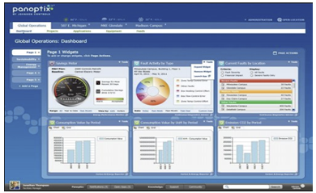
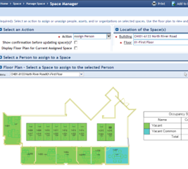
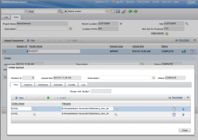
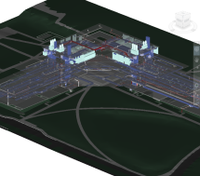
Design Intent
Design Model
Model Evolution
Design
The model should evolve from design concepts to operations without any data loss recapture or reentry.
Engineering
Bid Model
Specification
Construction
Unified Clash Detection Model
FAB Models
Construction Management System
Field data
“As Built”
Operations
Model
COBie
Product Catalog
Construction
COBie
Document Management
COBie
Operations
Retrofit
“As Maintained”
Building Control System
IWMS
CAFM/CMMS

Slide 7
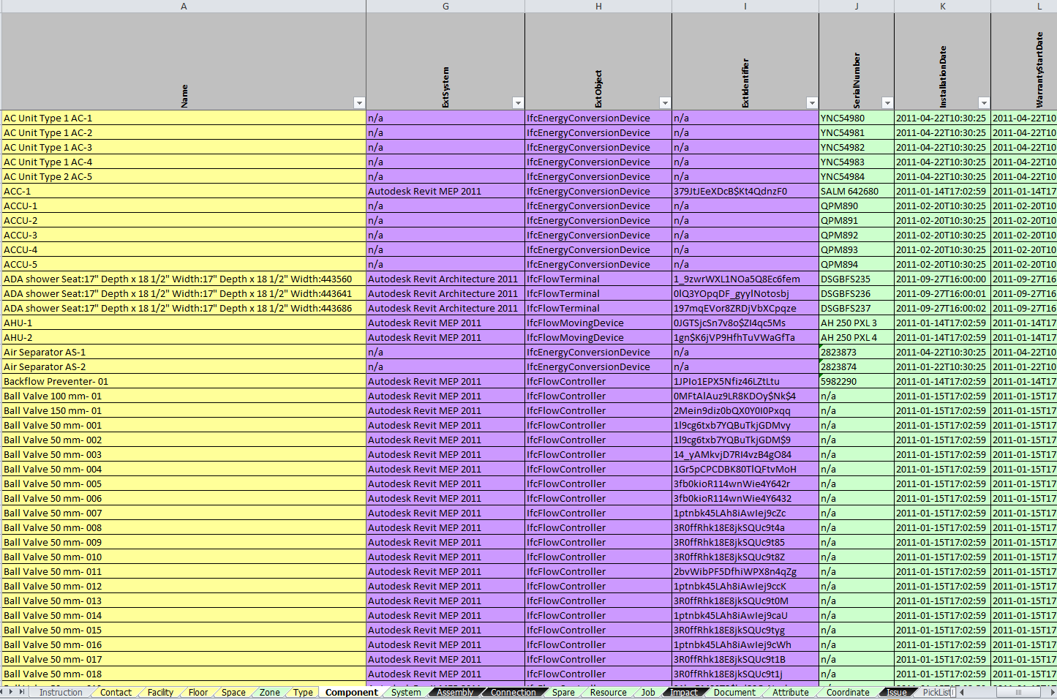


What is COBie?
An Actress?
Construction
Operations
Building
information
exchange
A Spreadsheet
An Open Standard managed by BuildingSmart
A Relational data model
A Contract Specification that allows owners to specify what data is required at hand-over
Notes:
It’s all of the above (but we don’t care about the actress)
COBie data is typically transmitted via a spreadsheet, but the spread sheet contains a moderately complicated relational data model. Most COBie spreadsheets are generated by export from a design tool or construction data management tool
Bill East, the COBie founder continual insists that COBie isn’t a spread sheet, and the industry continual finds a spread sheet to be the easiest file format to use to transfer COBie data.

Slide 8
COBie Structure
Facility: Single record describing Facility, Site, and Project
Every COBie package must have exactly one Facility
Floor: Level or Floor,
Implicitly reference Facility
Space: Rooms or other indoor or outdoor bounded spaces
References Floor
Component: Any building element that is not a space.
References Space and Type.
Type: Think Family. Describes characteristics common to many components
References Contact
Zone: A collection of Spaces
System: A collection of Components
Job: A sequential set of steps describing a maintenance procedure
References Space and Type.
Contact: Contact reference by email. May imply a company
Attributes: Properties- Name-value pairs
Can reference any row on any other table
Document: References to files or URLs
Can reference any row on any other table
Design models such as those done in Revit contain:
Facility (Implied)
Floor, Space, Component, Attributes
Some Types
May have system or zone
Notes:
Information not in Revit or Microstation models needs to come from construction management tools such as BIM360 or from product vendors

Slide 9



BIM data flow from Revit to Maximo
Extract Maximo Data definitions
Build Classification Manger database
Define Revit shared parameter for Maximo attributes
Define Forge Viewer storage
Define Maximo filters and Attribute Mapping
Upload model file(s)
Create model
Link related model files
Revit Model checker
Fail
Maximo COBie Validate checker
Request model translation
Pass
Pass
COBie export
COBie Import
Associate translated model with location

Slide 10
Data Export from Revit

Slide 11
Revit COBie Export
Extract Maximo Data definitions
Build Classification Manger database
Define Revit shared parameter for Maximo attributes
Define Forge Viewer storage
Define Maximo filters and Attribute Mapping
Upload model file(s)
Create model
Link related model files
Revit Model checker
Fail
Maximo COBie Validate checker
Request model translation
Pass
Pass
COBie export
COBie Import
Associate translated model with location

Slide 12
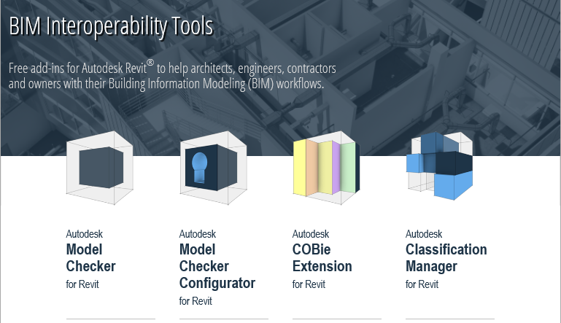
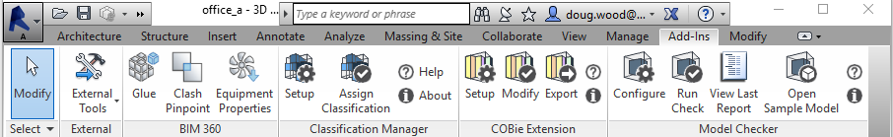
Get the right toolkit
http://www.biminteroperabilitytools.com/
Revit includes free add-in toolkits to validate that the model is COBie compliant, and to extract COBie data from the model
Version 2.0 icons are different from previous version so you can tell what is installed

Slide 13



Steps to Run COBie Export
Setup
Contacts
Create Contact
Settings
Specify ID formats: Space, Type, Component, System
Select attributes for export
Modify
Zone Manager: Create Zones
Elements: Select Family, Type, and Elements to export
Other Elements: Copy data to COBie schedules
Export
Select sheets and run export
Notes:
There are three separate tool used for the COBie export. They must be run in sequence
Setup: Configures toolkit behavior including how IDs are created. This step can be exported and used across multiple files
Modify: Determines what is exported, and prepares the COBie properties for export. It is safest to run this before every export
Export: Generate the COBie file.

Slide 14
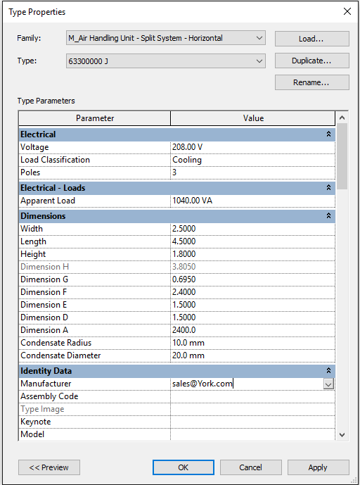
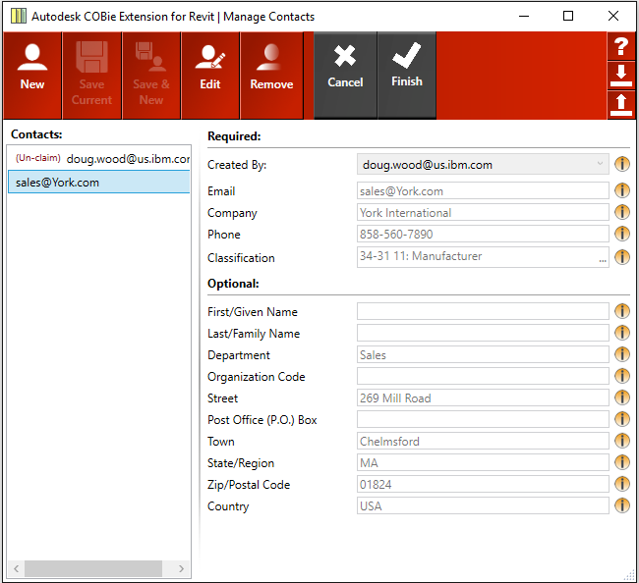
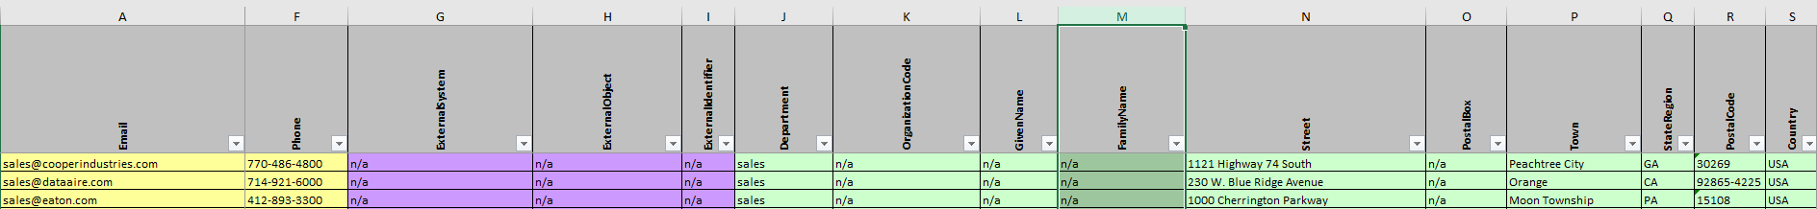
Contact setup
A company registry is build in the COBie toolkit contact tool. This list becomes the Contact table of the COBie file
Companies for the contact list are used for the Manufacture property in Revit type. The email from the contact definition is used as the value of the Manufacturer property
Notes:
COBie expresses company data in the form of contacts. The toolkit can include a company registry of companies referenced by Revit types. It also must include a singe contact that is the creator of the COBie data

Slide 15
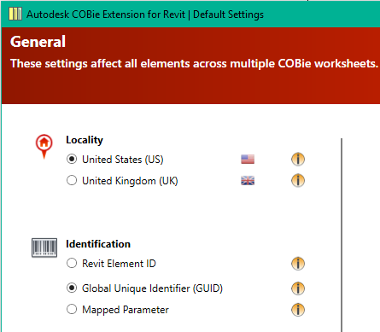
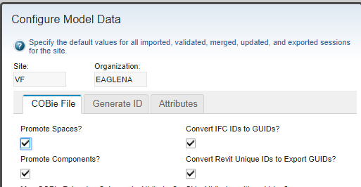
Unique Identifiers
There are 5 types of identifiers in common usage
Revit Element !D: An 8 digit number
Revit uniqueID: A 45 character concatenation of a internal Revit GUID and the Revit Element ID
Revit Export GUID: A GUID formed by Xoring the Element ID portion of the uniqueID with the last 8 character of the GUID portion of the uniqueID
IFC GUID: Used by IFC, including IFC format exported from Revit. It is a standard GUID represented in base64. If the IFC is generated from Revit, it’s a base 64 encoding of the Revit Export GUID
Custom: Any unique value the user provides may be used, but the user must have a means of generating it, and if it is going to be used with a viewer, it must be stored in a model property.
Maximo ID conversions on import
Convert the Revit uniqueID to the Revit Export GUID
Convert a base64 IFC QUID to a Hex representation.
Best Practice:
Select Globally Unique Identifier on the COBie export
On import, select “Convert Revit UniqueId’s to Export GUIDs”

Slide 16
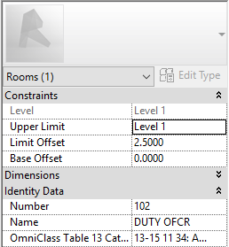

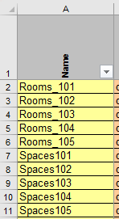
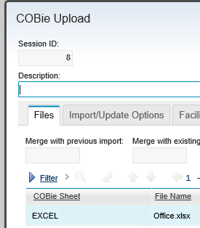
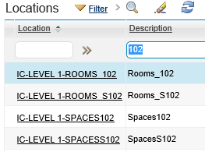
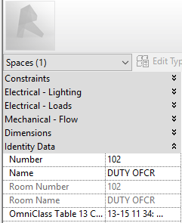
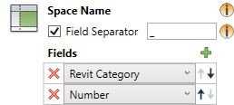
Room and Space – Typical use
COBie data for all files in the model are concatenated together to create a single COBie file. When elements with the same name appear in different model files, the name must be disambiguated before it is added to the COBie file
Revit category is added to space and room names to disambiguate them
Two Maximo records are created for the same physical space

Slide 17

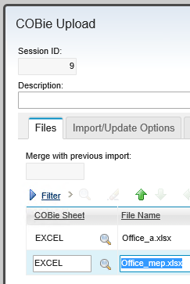
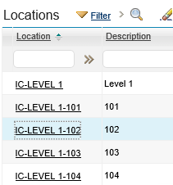
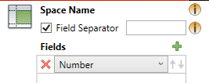
Room and Space setup – For Maximo
A separate COBie file is produced for each file in the model
Room or Space?
The COBie tool kit has a page to select which components are associated with a room, and which with a space. The defaults assume a single model file that contain both rooms and spaces. If linked models are being used and a given file only contains one or the other, then everything should be set to use what is in the model.
Room and Space names match
Rows with the same name in different files are merged on import into Maximo creating a single Maximo record

Slide 18
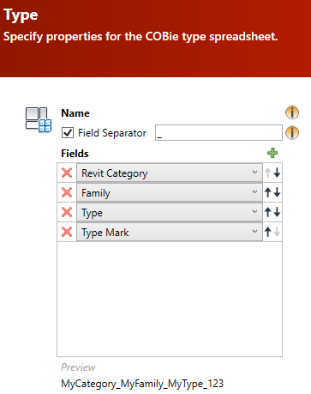
COBie Type name
Goal: To create an Identifier for COBie types that is both unique and human readable. How this is done depends on what data is in the model and what is desired in Maximo. A generally workable set of choices is displayed to the right. The Type Mark is expected to be unique. The other fields provide human readable information.
COBie Type name becomes the Maximo Product Name

Slide 19
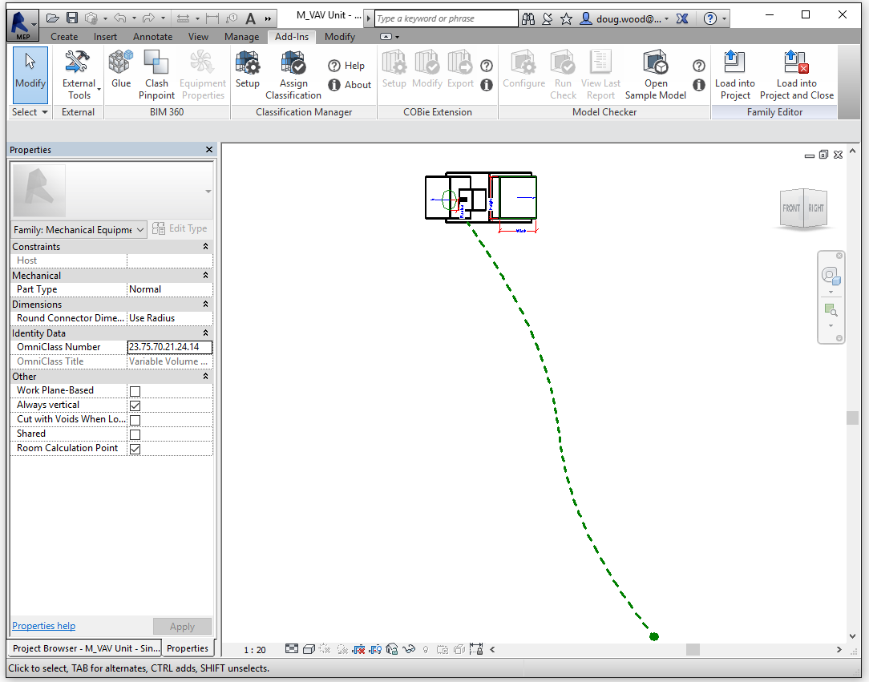
Making Revit Families Room Aware
Some families may need to be made “Room Aware” to properly associate with a Room or Space
Notes:
Every Revit element to be exported to COBie should be contained in a room or a space, and should be room aware so that it accurately reflects its placement. In some case this may require the creation of additional spaces such as an exterior mechanical pad

Slide 20
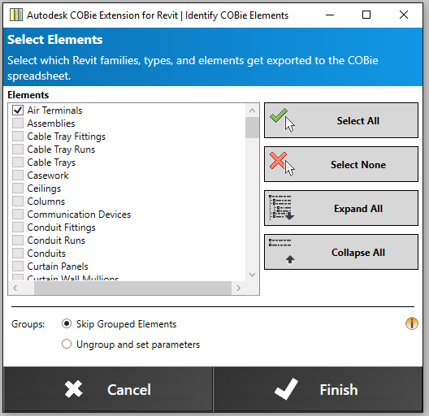
Select Elements
Select by family and type what is exported
Recommendation:
If you are getting your COBie from someone else, err on the side of caution and request anything you might want, then filter at the Maximo import
If you are doing your own import, then its worth spending some time fine tuning this and working with the import filters
When new elements are added to the model, by default they are not included in the COBie data even if the top level family is check for the element. It is best to review this tab anytime the model has been modified since the last COBie export

Slide 21
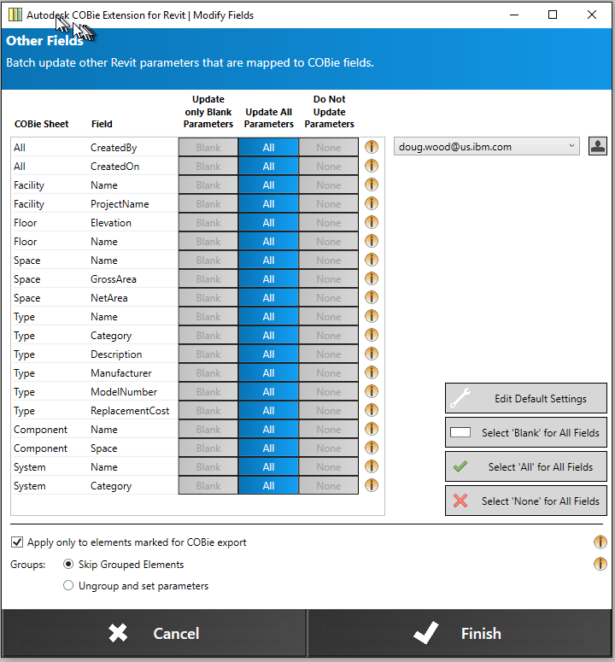
Other Fields
The COBie toolkit uses several instance and type parameter prefixed with COBie to store data before generating the COBie spreadsheet. Some of these field are copied directly from Revit properties, some are calculated, and some must be entered by the modeler. This step updates the copied and calculated field. It is possible to manually override the copied and calculated fields. The toolkit provides several options for updating these fields to prevent overwriting of manual overrides.
Best practice is to not override any values provide by the toolkit. Instead to insure that the necessary data in the model is provided so the toolkit generated the needed values.
If this is followed, then each time an updated COBie spreadsheet is to be generated, this screen must be visited and “Select All” clicked to cause all fields to be updated

Slide 22
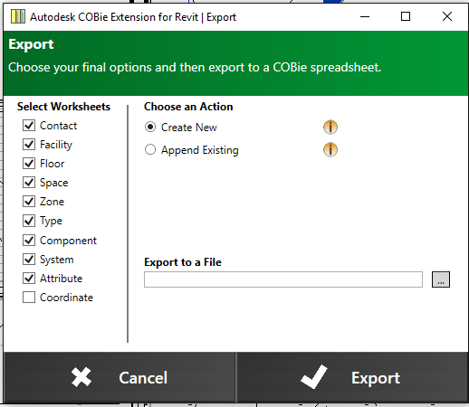
COBie Export
For Maximo, always select “create new” allow Maximo to merge the COBie file from linked models
Note: There are performance issue with the Excel interface. Writing large COBie data sets can take days to complete. Most of the data is attributes. Some careful though about what attributes are actually needed can improve export performance.
Maximo does not support the Coordinate table

Slide 23
Data Import into Maximo

Slide 24
Maximo Model Validation
Extract Maximo Data definitions
Build Classification Manger database
Define Revit shared parameter for Maximo attributes
Define Forge Viewer storage
Define Maximo filters and Attribute Mapping
Upload model file(s)
Create model
Link related model files
Revit Model checker
Fail
Maximo COBie Validate checker
Request model translation
Pass
Pass
COBie export
COBie Import
Associate translated model with location

Slide 25
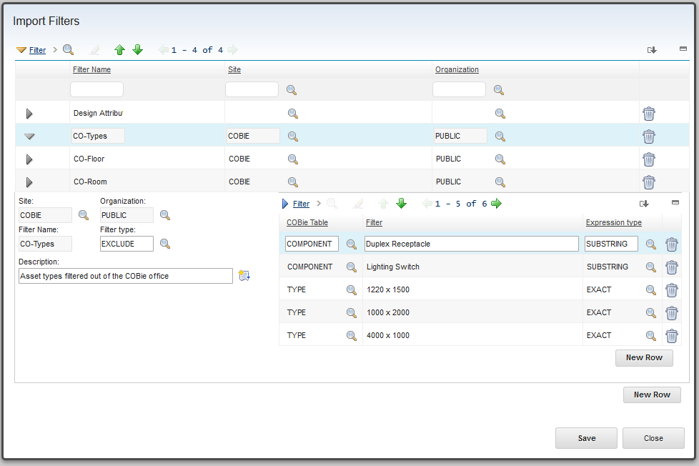
Define filters
COBie table the filter applies to
Filter Type
Substring
Exact Match
Regular Expression
Filter string
Filter either specifies what is included or what is excluded
Filters provide control over what COBie data is imported.
Filters are applied to the name field of the specified COBie table
Filters stack. For exclude, if an item matches any filter it is excluded. For include, if an item matches any filter it is included
Filters cascade.
Excluding a type excludes all components that reference the type.
Excluding a space excludes all components that reference it
Excluding a floor excludes all spaces, and therefore all components that reference it
Notes:
Filters are reusable across import projects. Build up a library of standard filters for you orginzation.

Slide 26
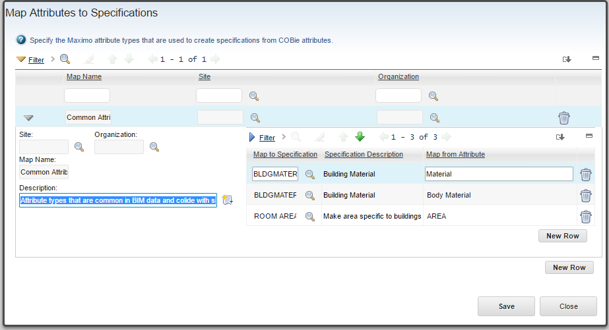
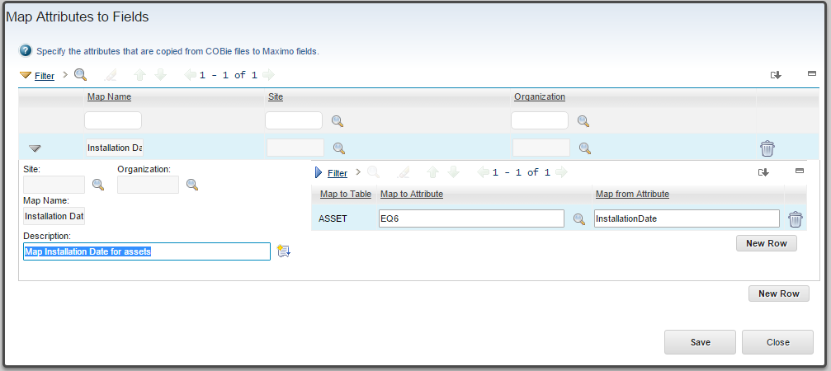
Define Attribute Maps
There are two types of Attribute Map
Mapping COBie attributes to fields in a Maximo table (Mbo). This is particularly useful when tables have been extended with custom fields that need to be populated with COBie data
Overriding the attribute type name matching provided by the import. This is useful when the parameter names in the model don’t conform to the enterprise standards
Override the import attribute name matching
Maximo attribute type
COBie Attribute name
Populate custom Mbo fields with COBie data
Mbo name and field
COBie Attribute name

Slide 27
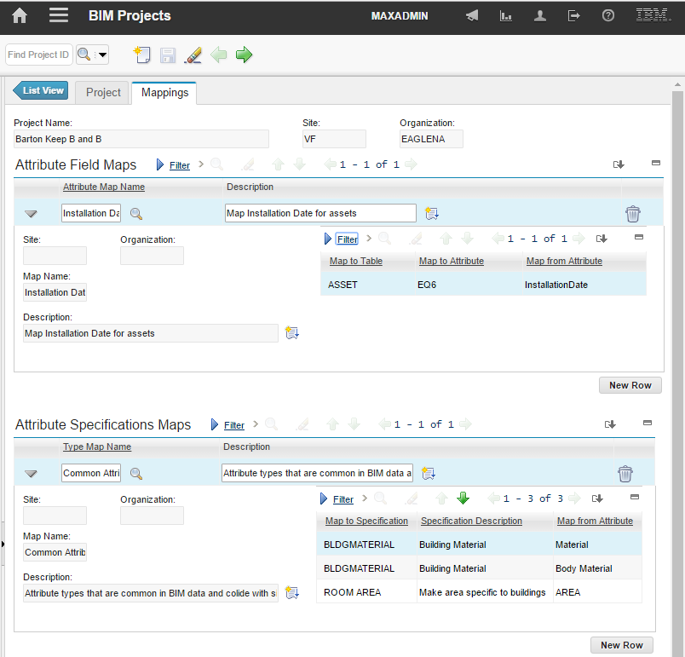
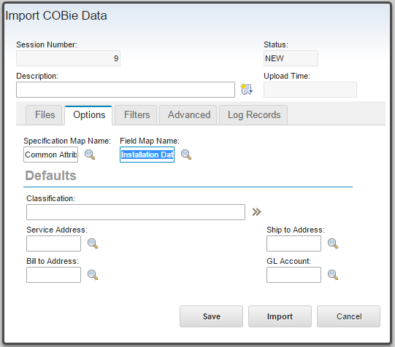
Add Attribute Maps to the Project
Specification and Field maps are create independently of an import project in a reusable library then associated with projects and session
Session map can over ride project map. Session maps should be used sparingly. They are only intended to address project compliance issues.
Field Map selected from library
Specification Map selected from library

Slide 28
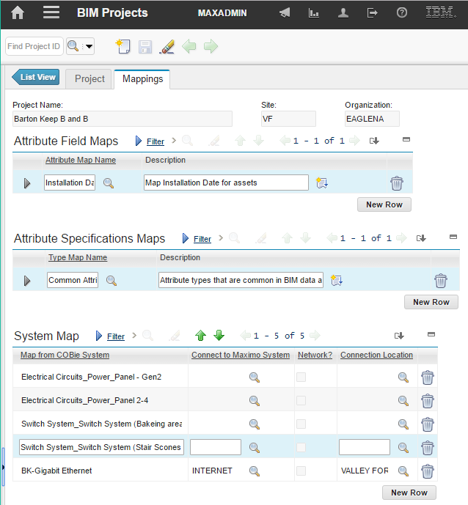
Map COBie systems to Maximo Systems
BIM models typically have a large number of small flat systems. For example: Each electrical circuit is a system. Maximo typically has a small number of large deep systems For example: The electrical grid for a site. The system map allows systems from a COBie file to be appended to an existing Maximo system at a specified point instead of creating a new Maximo system.
The list of all systems in a model may be extracted by running a validate session
List of all systems in the model generated by validate or induvial system names manually entered
Maximo system to which Model system is to be appended
Location where model system is appended

Slide 29
Maximo Model Validation
Extract Maximo Data definitions
Build Classification Manger database
Define Revit shared parameter for Maximo attributes
Define Forge Viewer storage
Define Maximo filters and Attribute Mapping
Upload model file(s)
Create model
Link related model files
Revit Model checker
Fail
Maximo COBie Validate checker
Request model translation
Pass
Pass
COBie export
COBie Import
Associate translated model with location

Slide 30
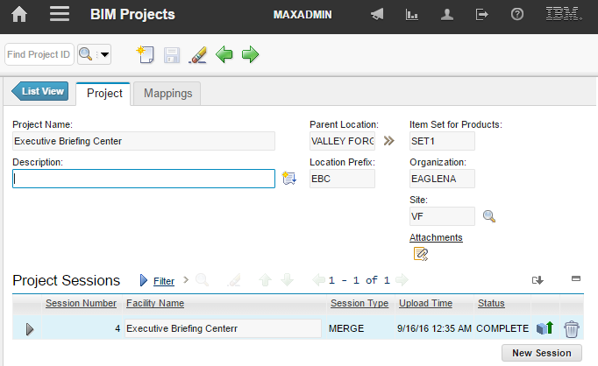
Model Validation – Create Import Project
This will be the parent location for the location tree created by the import starting with a location for the Facility
Unique human readable project name
A value the uniquely identifies the building in Maximo. Used as a prefix for auto-generated values for Location and AssetNum
Site used for imported data
Notes:
An import/Export project manages all interaction with a specific facility to create a new project:
Specify a unique human readable project name
Specify the parent location for the location tree created by the import. Typically, the first location created by the parent is the facility
A unique prefix to identify the building. This is used in generation of location and assetnum values

Slide 31
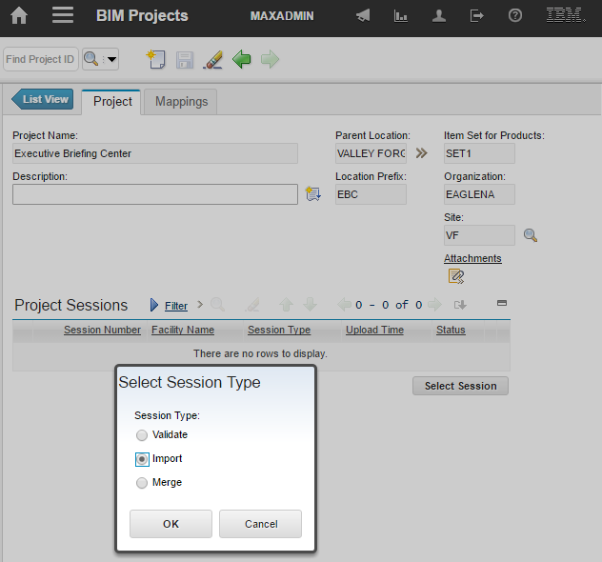
Model Validation – Create Validate Session
Create a new session for any import or export activity
Notes:
To create a new Validate session:
Select “New Row” for the session table
Select “Validate” from the session type dialog
A validate session runs the Maximo COBie validation tool. This is a two pass process.
The first pass test the structure of the COBie file
The second pass tests matching of COBie data against existing Maximo data
A Validate session makes no changes to the Maximo database. Validate should be run iteratively with model updates until the model meets the desired requirements. The validation tool test many of the owner’s data requirements such as:
Attribute names and data types
Units of measure
Classification
It may also be used to test how COBie data matches against existing Maximo data for the facility

Slide 32
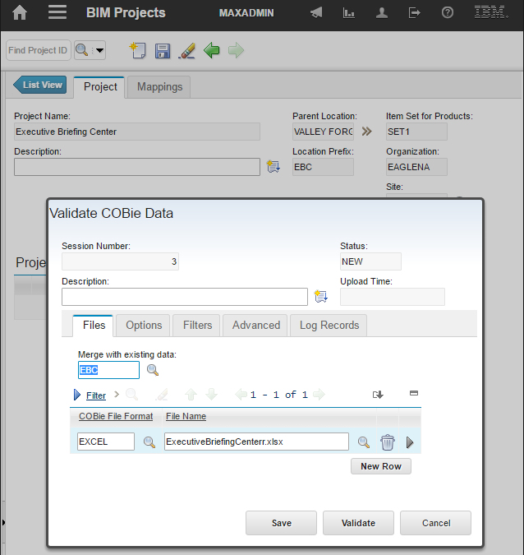
Model Validation – Merging Models
If model data is to be add to or overloaded on existing Maximo data for the facility, then a Merge session should be used.
For a Merge session to work, the location and assetnum field values generated by the import need to match the values of the Maximo records they are to be merged with. There are several strategies to accomplish this. Careful use of both the COBie toolkit ID generation setting and the Maximo COBIe imprort ID generation settings can help, but there will usually be some amount of manually work
Once the merge is complete, the Maximo records are linked to the model and subsequent import and updates will automatically match against the data. The linking also allows the viewer to be used for these records
Select an existing facility location to test merging with existing data
Notes:
Select all the COBie files that comprise the model data
The Maximo COBie validate and import can merge multiple COBie files on import. This is the preferred approach for handling models with many linked files.

Slide 33
Model Validation – Sample validate messages
ATTRIBUTE:SYSTEM:Mechanical Supply Air 1:Number of Elements is a duplicate
COMPONENT:Mechanical Equipment_41_593090 is missing a reference to SPACE
The reference in TYPE:Plumbing Fixtures_M_Grab Bars_8370-001420 to CONTACT:Bradley Corporation cannot be resolved
Validate ATTRIBUTE TYPE ===> Supply Air Inlet Diameter
Warning: ATTRIBUTE TYPE Supply Air Inlet Diameter Invalid units HVAC_DUCT_SIZE. Units must be defined in Maximo before they can be imported
Validate ATTRIBUTE TYPE ===> Lighting - Dwelling Unit Connected
Warning: ATTRIBUTE TYPE Lighting - Dwelling Unit Connected Invalid units ELECTRICAL_APPARENT_POWER. Units must be defined in Maximo before they can be imported
Validate CONTACT ===> doug.wood@us.ibm.com
Warning: Item CONTACT:doug.wood@us.ibm.com - Category Software Architect not found. Categories must be a valid Maximo classification
Validate FACILITY ===> BSA Office
Validate FLOOR ===> Level 1
Validate SPACE ===> 104
Validate COMPONENT ===> Lighting Devices_646165
Validate SYSTEM ===> Switch System

Slide 34
Maximo Model Validation
Extract Maximo Data definitions
Build Classification Manger database
Define Revit shared parameter for Maximo attributes
Define BIM360 Viewer storage
Define Maximo filters and Attribute Mapping
Upload model file(s)
Create model
Link related model files
Revit Model checker
Fail
Maximo COBie Validate checker
Request model translation
Pass
Pass
COBie export
COBie Import
Associate translated model with location

Slide 35
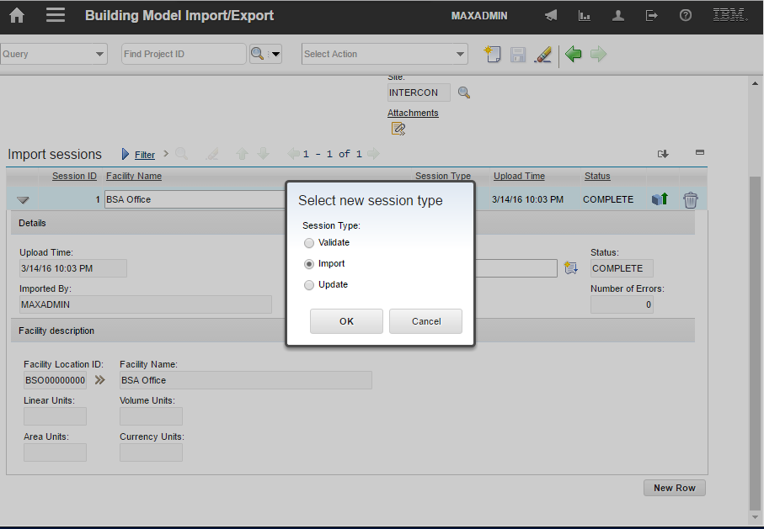
COBie Upload
Notes:
Use import sessions for new buildings, including adding additional data to and existing import, such as from a linked model received after the initial import
Use update sessions to merge COBie data with pre-existing Maximo data for the building or for updating previously imported COBie data
To merge with existing data, the location and assetnum values created by the import must match with existing records.

Slide 36
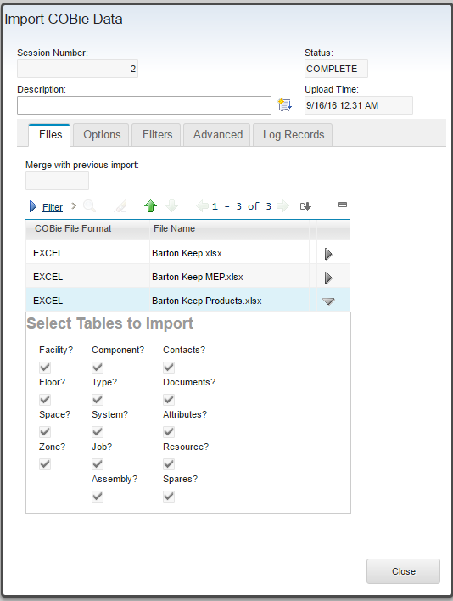
Importing COBie files
Add filters here
Specify the attribute map here
COBie files from linked models are merged here
Select table to import
Notes:
Advanced setting are copied from the site level BIM Configuration. This provide many options on how the imported data appears in Maximo. The most commonly changed are the options for creating Location and AssetNum field values

Slide 37
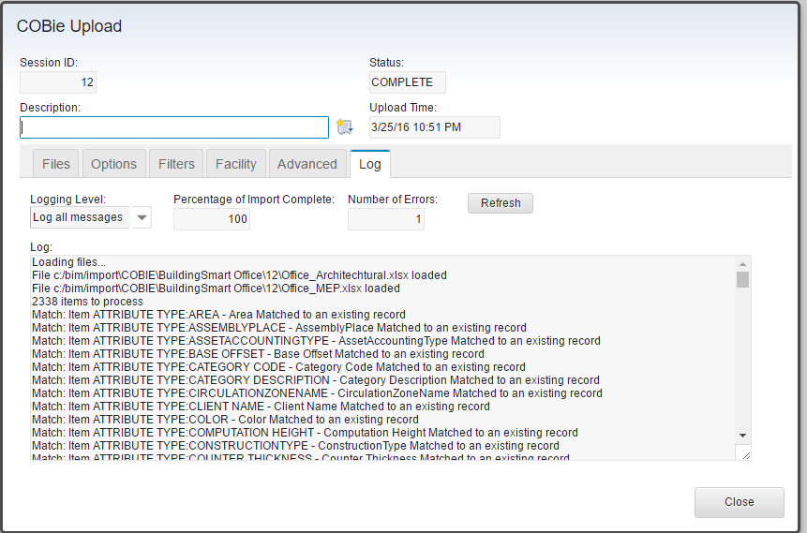
COBie Log Record
Updates the % complete and the # of errors.
Once started, all of the COBie processes such as the import show here run in the background.
Both the dialog and the browser can be closed and returned to at a later time
The log is stored in the database providing a permanent record of the import

Slide 38
Maximo Model Validation
Extract Maximo Data definitions
Build Classification Manger database
Define Revit shared parameter for Maximo attributes
Define BIM360 Viewer storage
Define Maximo filters and Attribute Mapping
Upload model file(s)
Create model
Link related model files
Revit Model checker
Fail
Maximo COBie Validate checker
Request model translation
Pass
Pass
COBie export
COBie Import
Associate translated model with location

Slide 39
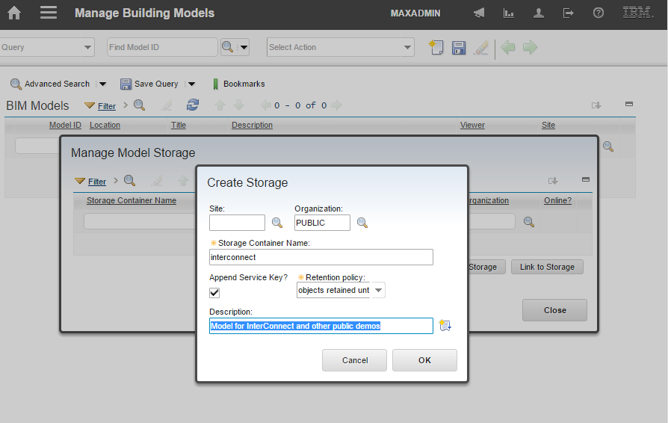
Creating storage containers
Apply Maximo security to access to the container from Maximo
Automatically append BIM360 Application key to insure uniqueness of the container name
Determines how long model files stored in this container are retained
Notes:
The BIM360 model management functions are found under the Manage Building Models application.
Select Actions -> Manage Autodesk Cloud -> Manage Storage
To use the BIM360 viewer one or more storage containers must be created to hold the uploaded model file.
The storage container name must be unique across all users of the BIM360 service. To insure this, best practice is to the user’s key to each storage container name. Maximo makes this transparent to its users. An alternate approach is to include a string that is guaranteed to be unique such as a domain name registered to your organization
Models can be retained in the storage container for various lengths of time. The life to the viewable data translated from the model is separate from the model file so it is not necessary to retain the model files beyond successful translation
If a storage container already exists, for example it was created in a test environment, then it can be linked into a new Maximo server instead of created.

Slide 40
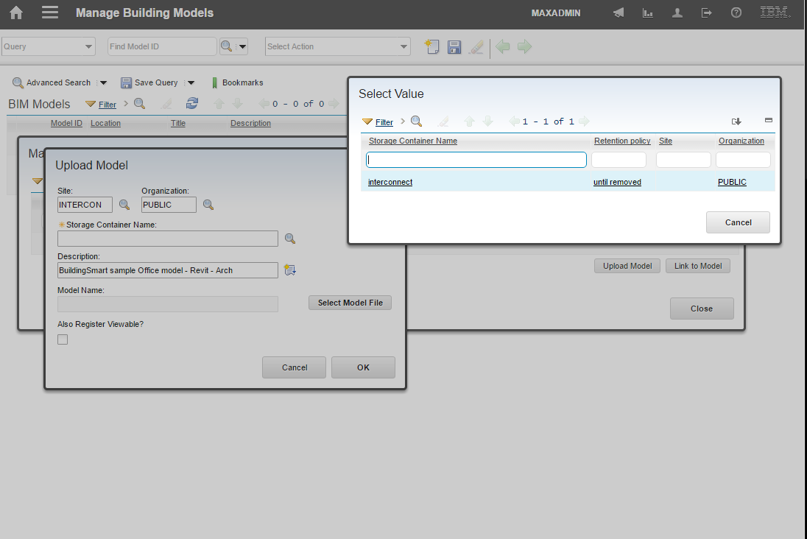
Model upload – Select storage container
The Storage Container list is filtered by the site and organization seleted on the Upload Model dialog
Notes:
The BIM360 model management functions are found under the Manage Building Models application.
Select Actions -> Manage Autodesk Cloud -> Manage Storage
The model management functions uploads model files: Revit and NavisWorks, to the BIM360 cloud.
Each model must be placed in a storage container created in the previous step. Available storage containers are filter based on the optional organization and site selected for the model.

Slide 41
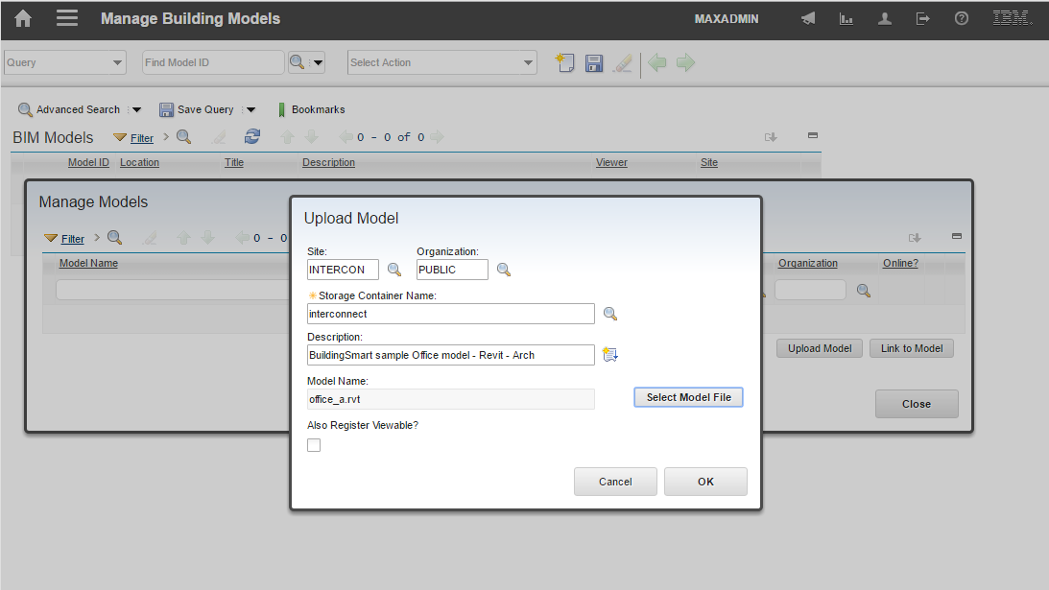
Model upload – Specifying the model file
Automatically register for viewable translation eliminating that step. Can’t be used for linked model

Slide 42
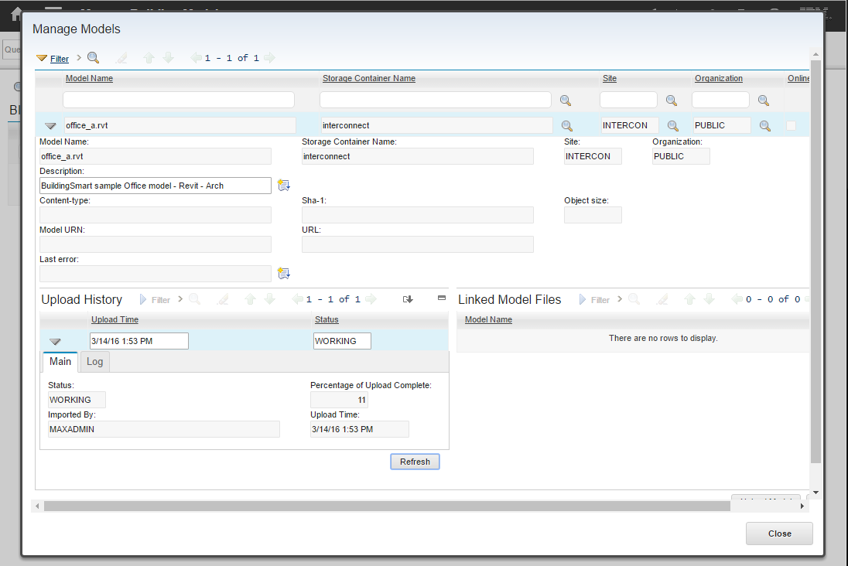
Model upload – Background processing
The model is uploaded from the Maximo server to the Autodesk cloud in the background. Progress is displayed on the Manage Models dialog
Notes:
Once the upload is started, it runs in the background and progress can be monitored from the Manage Models dialog.

Slide 43

Model upload – Defining links
The list of files available to link is filtered by the site and org of the master model
For a link to function, the upload filename must be the same as the base filename in the link within Revit
Notes:
Many Revit models are assembled from a group of linked files. Often these files are organized by discipline such as mechanical, structural and architectural, or by trade within the Mechanical. For the model to be viewed in Maximo as a single entity, the links must be communicated during the upload process.

Slide 44

Model Registration
Notes:
Once all member files of a model are uploaded and linked, the model must be submitted to Autodesk cloud services for translation into viewable format. This is done through the Manage Viewable Models dialog
Select Actions -> Manage Autodesk Cloud -> Manage Viewable Models

Slide 45

Model Registration – Monitoring Progress
Translation progress can be monitored from the Mange Viewable Models dialog
Notes:
Translation may take a few minutes to several hours depending on the size and type of the model, and the number of linked files. Revit models take longer than NavisWorks models

Slide 46

Associate Model with a location
Notes:
The model must be associated with a Maximo location. It is then displayed for that location and all child locations and assets. The locations is typically the facility created by the COBie import of the model data.
Create a new Mange Building Models record
Select the location the model is linked to. This is typically the facility created by the COBie import of the model data
Select the model from the list of viewable models. The site and origination, if specified, must match the site and organization of the selected location

Slide 47

Notes:
Use the view tab to preview the model

Slide 48
Using Navisworks Files
Navisworks .NWD files can be used with the Forge viewer
Using Navisworks files has several possible advantages:
Navisworks has a visual representation of Room and Space object which Revit does not
It is easy to customize the visual representation of a Navisworks file, such as color coding objects by type
It may be possible to import file formats not normally usable by the Forge viewer into Navisworks and display them
This example assumes that Navisworks is being used to display Room objects, that space object are not displayed, and that the original source is a Revit model consisting of an Architectural and. an MEP file. This assumes that the mechanism described here: Room and Space – Typical use was used for the COBie import
The following steps are required to create the Navisworks .NWD file and configure it for use in Maximo:
Export .nwc files from each revit model file
Merge the .nwc files into a single Navisworks model
Override color and transparency of Room and any other desired objects
Hide Spaces objects and any other objects not desired in to be seen in the Forge viewer
Set the default view
Save the models as an .nwd file
Upload the .nwd file to the Forge service and request translation (See slides Model upload – Specifying the model file)
Associate the model with a Maximo location (See slide Associate Model with a location )
Configure the property binding between Maximo and the model

Slide 49



Export Navisworks Files from Revit
Use the Revit plug-in to export a .nwc file from each Revit model in the project. The Exporter provided better control and translation than opening the Revit model directly in NavisWorks
NavisWorks Exporter
Select which properties to convert, You need to insure the ID property is converted
Include rooms
Display Export Settings

Slide 50


Build .NWD file
Use the property browser to fin and select all the room all the rooms
Display the property menu for the selection, Override Color and Transparency to create the desired visual effect. By default rooms are almost invisible
Select all the spaces, and hide the space.
Setup the view desired in the view. This may include hiding additional object or overriding color. It is fairly easy to use the category tree to color code elements based on category
Save the file as a .NWD file. The view visible when the file is save is what is imported in the Forge viewer
Upload and translate the .NWD file

Slide 51

Find Unique ID in the model
Maximo ID for location or asset – From COBie import
Navisworks property that matches the Maximo ID
It is usually GUID or Guid
Open the NavisWorks Property dialog here

Slide 52


Set Navisworks name of ID property
Name of Navisworks property from previous step
COBie External Identifier
Converted from Revit UniqueID to GUID on Import

Slide 53


Building Information Model Extensions for Maximo
What’s Included?
COBie data import
3D BIM Viewer
Maximo extensions for BIM data
Available:
COBie import: Maximo feature Pack 7.6.0.6
Forge Viewer Plug-in: on the ISM Library
COBie to Maximo Mapping
COBie | Maximo Import location
Facility | Location and COBie import project
Floor | Location
Space | Location
Component | Location and Asset
System | System (Category configurable)
Zone | System (Category configurable)
Type | Product (New for COBie support), Item
Attribute | Specifications for: Location, Asset, Product, Item
Contact | Person, Company, Company Contact
Document | Attachment
Job | Job Plan, InvVendor, PM, ProductJob (New)
Resource | Toolitem, Job Plan Tools
Spare | Product parts (New)
https://www.ibm.com/developerworks/community/wikis/home?lang=en#!/wiki/IBM%20Maximo%20Asset%20Management/page/Maximo%20BIM%20Forge%20Viewer%20PlugIn
Standards
IFC http://www.iai-tech.org/ifc/IFC2x4/beta3/html/index.htm
gbXML http://www.gbxml.org/
COBie http://www.wbdg.org/resources/cobie.php
OMNIClass http://www.omniclass.org/
COBie Certified
http://buildingsmartalliance.org/index.php/newsevents/proceedings/cobie2011challenge
Marketing POC
name: Kawon Park
phone: 978-899-4581
email: kpark@us.ibm.com
Technical POC
name: Doug Wood
email: doug.wood@wipro.com

